Slide 1
Embedded Linux Project Research
Danielle Bolan

Slide 2

Node.js
Node.js tutorial and basic programming
a platform built on Chrome's JavaScript runtime for easily building fast, scalable network applications.
installation and creating modules

Slide 3

Mongo DB
an open-source document database, and the leading NoSQL database.
Installation, accessing database, displaying data

Slide 4

Angular.js
an open-source JavaScript framework, maintained by Google, that assists with running single-page applications.
Tutorial on how to construct a angular.js webb app

Slide 5
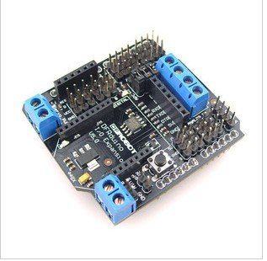
Adrduino Xbee
The Arduino Xbee shield allows your Arduino board to communicate wirelessly using Zigbee
Tutorial: Configuration

Slide 6
Update:
Can access data in database
Not able to do real time updates

Slide 7
New Problems
Do not have temperature sensor
Need to find a different way of displaying the graph

Slide 8
Sources
http://net.tutsplus.com/tutorials/javascript-ajax/node-js-for-beginners/
http://docs.mongodb.org/manual/tutorial/getting-started/
http://docs.angularjs.org/tutorial
http://arduino.cc/en/Guide/ArduinoXbeeShield

